Slide 1
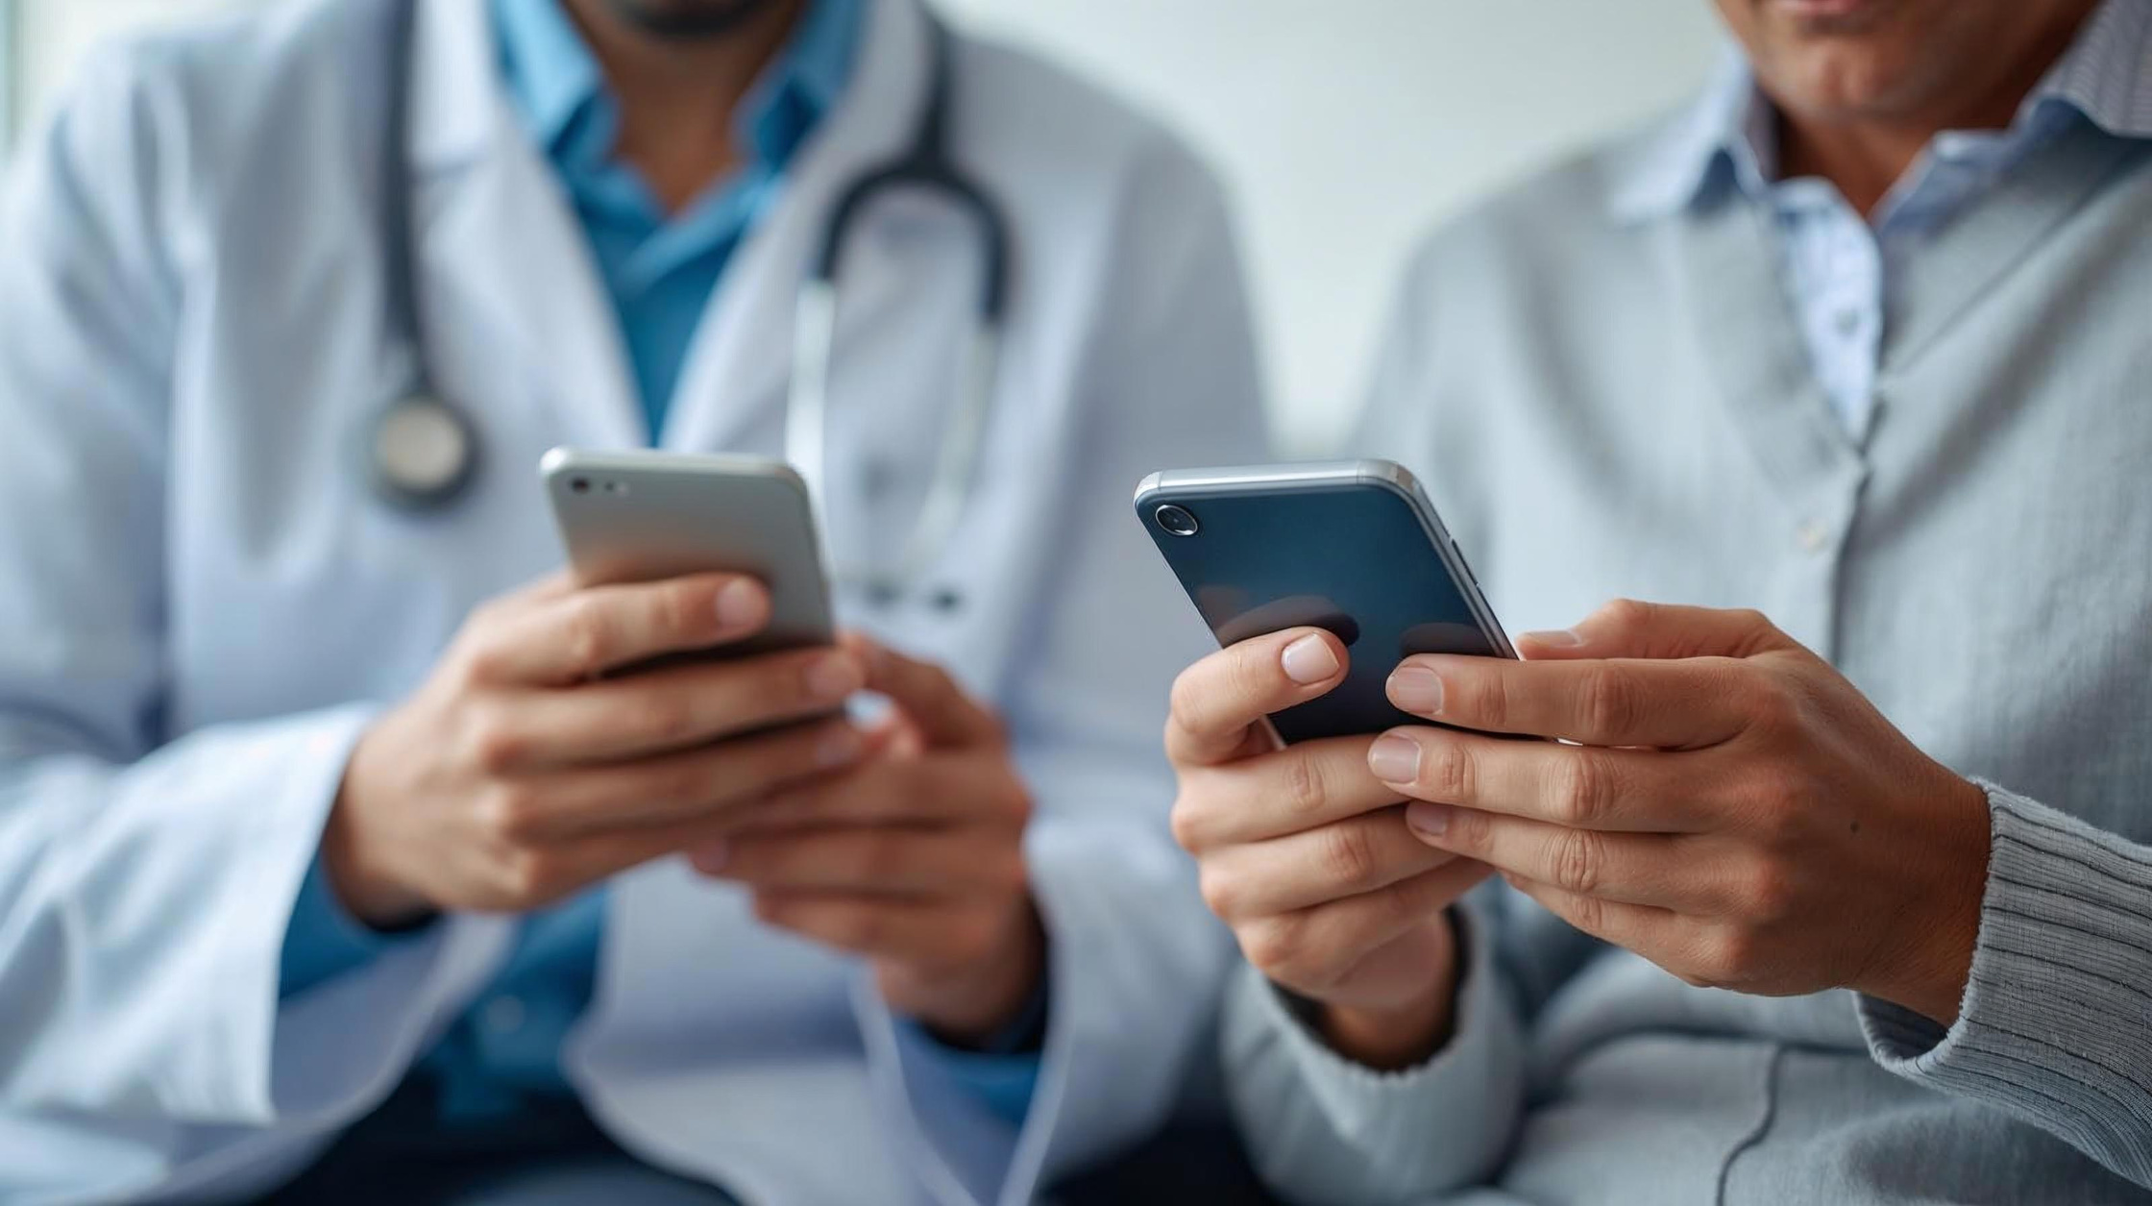

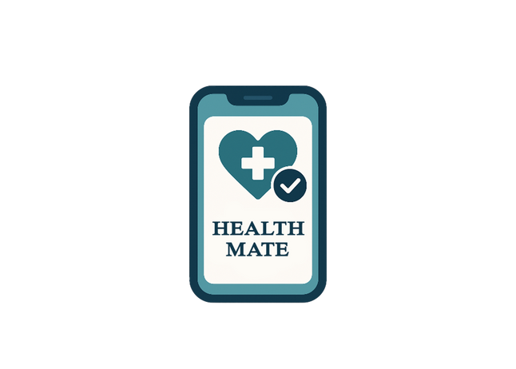

HealthMate
A Privacy-First Health Companion For Chronic Conditions

Slide 2






Overview
01
Introduction
02
Problem
03
Aim
04
Objectives
05
User Stories
06
Methodology
07
Proposed Approaches
08
Comparison
09
Resource Requirements
10
Design Preview
11
Time Estimate

Slide 3



Introduction
In Sri Lanka, Chronic diseases like diabetes and hypertension are on rise.
Patients with chronic conditions face daily challenges in tracking health medications.
Current methods (memory, paper logs, insecure apps) lead to errors and poor adherence.
Patients have major concerns about the security and privacy of their health data.
“HealthMate” is a privacy-first mobile app to support patients.
It provides digital care plans, secure health logging, reminders and AI-powered suggetions.

Slide 4




Problem
Lack of a simple digital daily care plan.
Inaccurate & inefficient manual tracking.
Ineffective doctor visits due to poor history visibility.
Patients often forget to take their medications on time.
Data privacy concerns with existing apps.

Slide 5



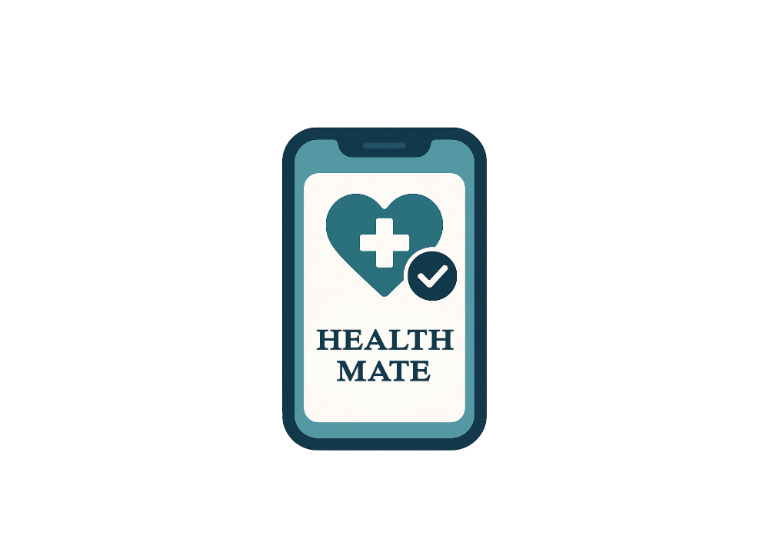

Aim
To develop a AI-based and privacy-focused mobile app that helps Sri Lankan users manage chronic conditions that enabling personalized plans, secure tracking, AI-powered suggestions and doctor-friendly reports.

Slide 6






Objectives
To Review existing digital health apps to identify gaps in privacy, usability and personalization.
To analyze user challenges in chronic conditions management.
To design a My Care Plan (MCP) for setting health goals, medication schedules and daily tracking.
To develop a secure system with AI support and personalized guidance.
To provide clear health data visualization and exportable reports for users and healthcare providers.
To test the application for functionality, usability and security.

Slide 7


User Stories
• As a patient:
I want to create my personal care plan so that I can follow my medication and goals easily. I want to log my daily health readings so that I can track my progress over time. I want to receive reminders so that I don’t forget important medication or health checks. I want to get AI-generated insights so that I can understand my health trends clearly.
• As a doctor:
I want patients to export clear health reports so that I can review their progress quickly. I want AI summaries included in reports so that I can identify key issues faster.
• As an admin:
I want to ensure data privacy and encryption so that patient information stays secure. I want to manage system settings and metadata so that the app functions reliably.

Slide 8


Methodology
The project follows an Agile-based development approach
Requirement Analysis: Identify patient needs and goals for daily care management.
Design: Create user friendly layout with clear options.
Development: Build main app features including user profiles, My Care Plan, data logging, reminders, progress visualization and AI features.
Testing: Check app performance, security and user-friendliness.
Deployment: Launch the MVP on the Google Play Store.
Evaluation: Gather user feedback to improve features.

Slide 9
Proposed Approaches
User Authentication & Profiles: Secure login with personalized health profile setup.
My Care Plan (MCP): Users set daily health goals, medication schedules and wellness routines.
Health Data Logging: Users record vital signs, symptoms and lifestyle activities.
AI Health Assistant: Provides personalized tips, reminders and health suggestions.
Local Analytics & Reports: Visual charts and exportable reports processed securely on the device.
User-Friendly Interface: Simple and Accessible design for easy navigation.
MVP Development: Launch an initial 3-month Minimum Viable Product on Google Play Store.

Slide 10
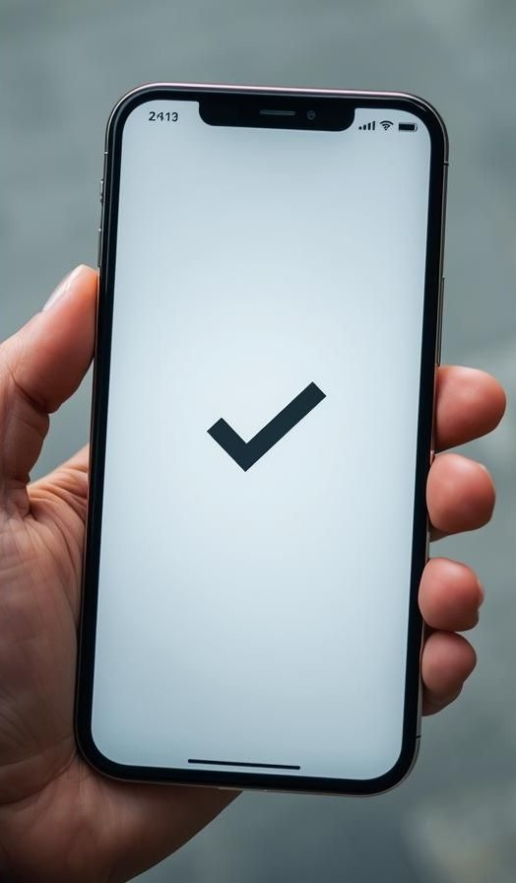
Comparison
Feature | Existing Apps | HealthMate
Data Privacy & Storage | Cloud-based, Data on External Servers | Privacy-First, On-Device Encryption
Personalized Reminders | Time-based, Simple Alerts | Intelligent, Non-Diagnostic Nudges (AI-Driven, Context-Aware)
Relevance & Customization | Generic care plans, Not tailored for local needs | Sri Lankan Context & NCD Focus, Personalized Care Plan (MCP)
Doctor Consult Reporting | Raw data dumps, Hard-to-read logs | Exportable PDF/CSV (Summary of trends)
Knowledge Base | None or Basic fixed rules | Neo4j Ontology-Based (Relates condition, meds and goals)

Slide 11

Resource Requirements
Software : React Native with Expo Go
Java Spring Boot Python
Firebase Firestore
Neo4j
LangChain
Libraries for PDF/CSV export
Hardware : Development computer
Android smartphone for testing
Internet Connection

Slide 12

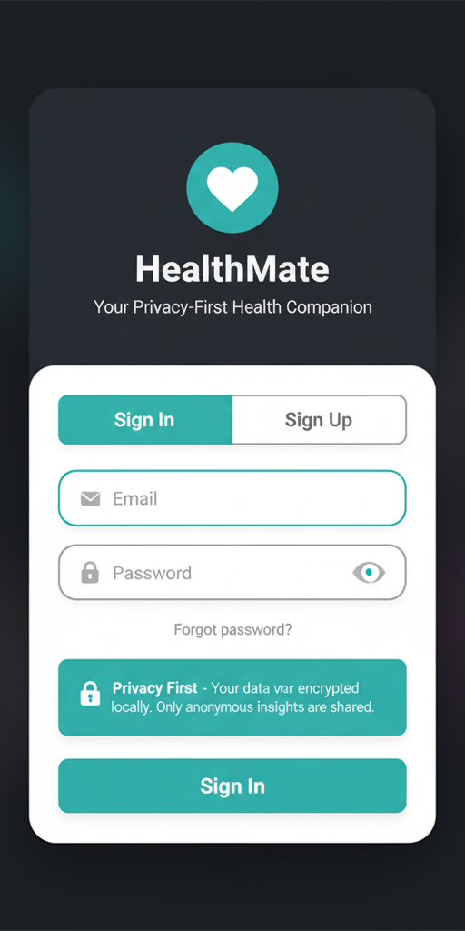
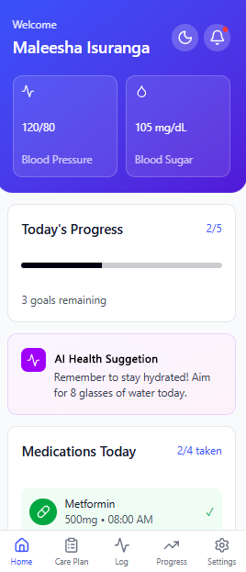
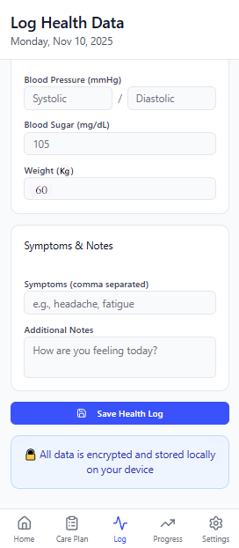
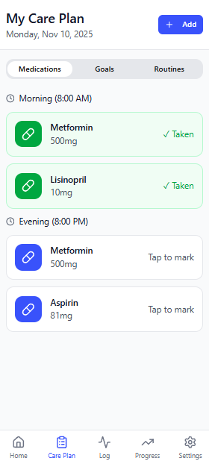
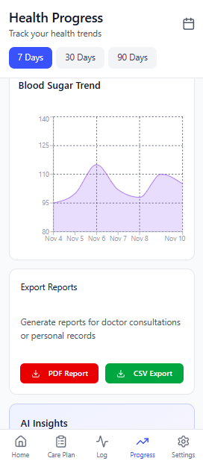
Design Preview
Home Page
Log Data
Care Plan
Progress
Login Screen

Slide 13




Time Estimate
Sprint | Features / Tasks | Estimate Days
Sprint 0 | Finalize requirements | 2
(week 1-2) | Backlog creation & prioritization | 1
 | Draft user stories (MVP core only) | 2
 | Initial wireframes (MCP, Logging, Dashboard) | 1
 | Refine wireframes | 2
 | Tech stack justification & architecture | 1
 | Firebase + encrypted DB initial setup | 2
 | Privacy & risk assessment (PDPA) | 1
Sprint 1 | React Native / Expo project setup | 2
(week 3–4) | Secure local storage (encrypted SQLite) | 3
 | User authentication (Firebase Auth) | 3
 | MCP basic UI + setup logic | 3
 | Navigation setup | 1
Sprint 2 | MCP goals & medication schedules | 3
(week 5–6) | Health data logging UI (BP, sugar, meds) | 4
 | Local DB integration for logs | 3
 | Basic dashboard charts | 2
 | User settings | 1

Slide 14
Sprint 3 | AI reminders (on-device logic) | 4
(week 7-8) | AI suggestions via LangChain microservice | 4
 | Neo4j ontology setup | 3
 | App ↔ Backend ↔ AI integration | 3
 | Push notification setup (FCM) | 2
Sprint 4 | Advanced charts & trends | 3
(week 9-10) | PDF report generation | 3
 | CSV export | 2
 | AI trend summarizer | 2
 | Health summary screen | 2
Sprint 5 | Full manual testing | 3
(week 11-12) | Bug fixing | 2
 | Integration testing | 2
 | UI polish + accessibility improvements | 2
 | Privacy Policy & Disclaimer (PDPA) | 2
Sprint 6 | UAT with small group | 3
(week 13-14) | Final bug fixes | 2
 | App polish for release | 1
 | Play Store assets (icon, screenshots, description) | 1
 | Final security/privacy review | 1
 | Play Store submission | 1

Slide 15







Thank You!!

